Slide 1
Polygon in Annulus

Slide 2
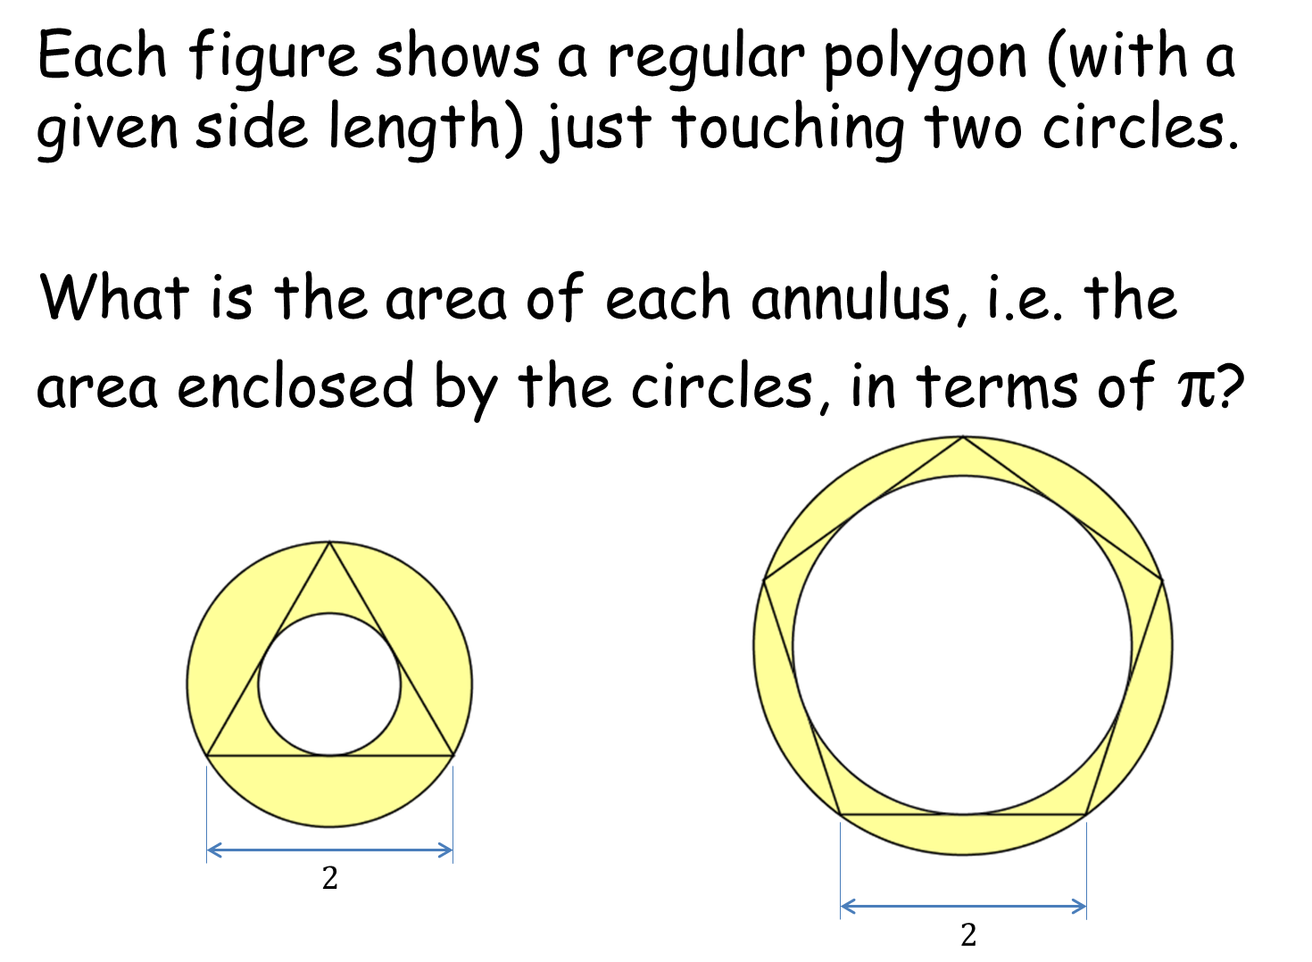
Polygon in Annulus
Notes:
3 5

Slide 3
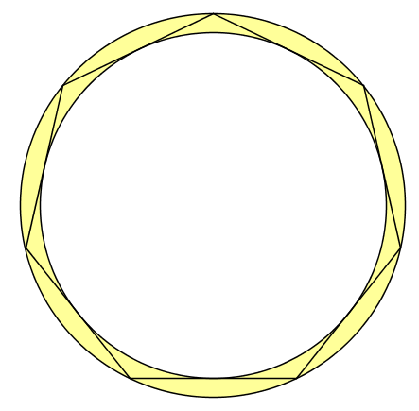





$$R$$
$$r$$
$$R$$
$$r$$
$$l$$

Slide 4


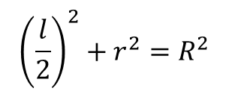
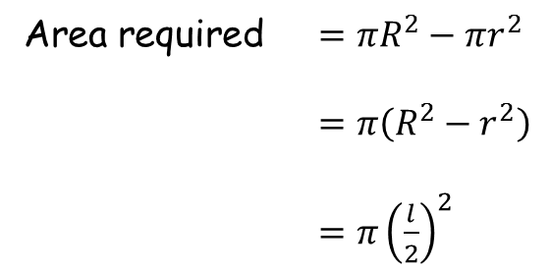



Area required $=πR^{2}−πr^{2}$
$=π\left(R^{2}−r^{2}\right)$
$=π{\left(\frac{l}{2}\right)}^{2}$
$$R$$
$$r$$
In our case $l=2$
$$R$$
So our area is
$π$
$$R$$
$$r$$
$$r$$
$$\frac{l}{2}$$
$$l$$
$${\left(\frac{l}{2}\right)}^{2}+r^{2}=R^{2}$$

Slide 5
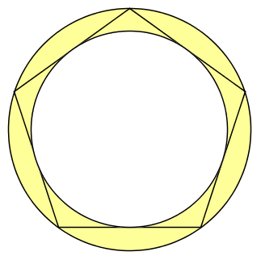
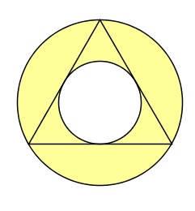



Each figure shows a regular polygon (with a given side length) just touching two circles.
What is the area of each annulus, i.e. the area enclosed by the circles, in terms of π?
$$π$$
$$2$$
$$2$$
Notes:
3 5

Slide 6
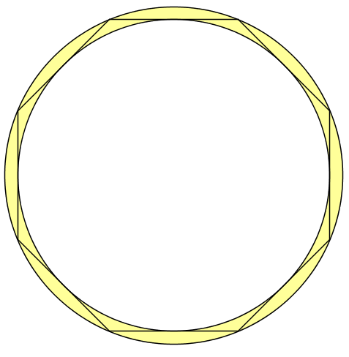

Slide 8
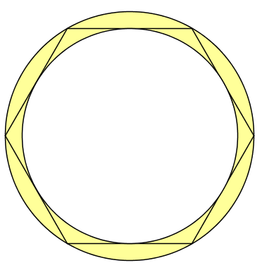

Slide 10
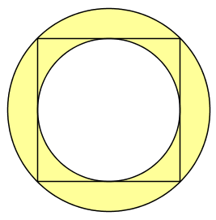

Slide 12
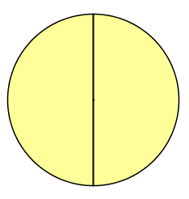
All the same area as this!

Slide 14
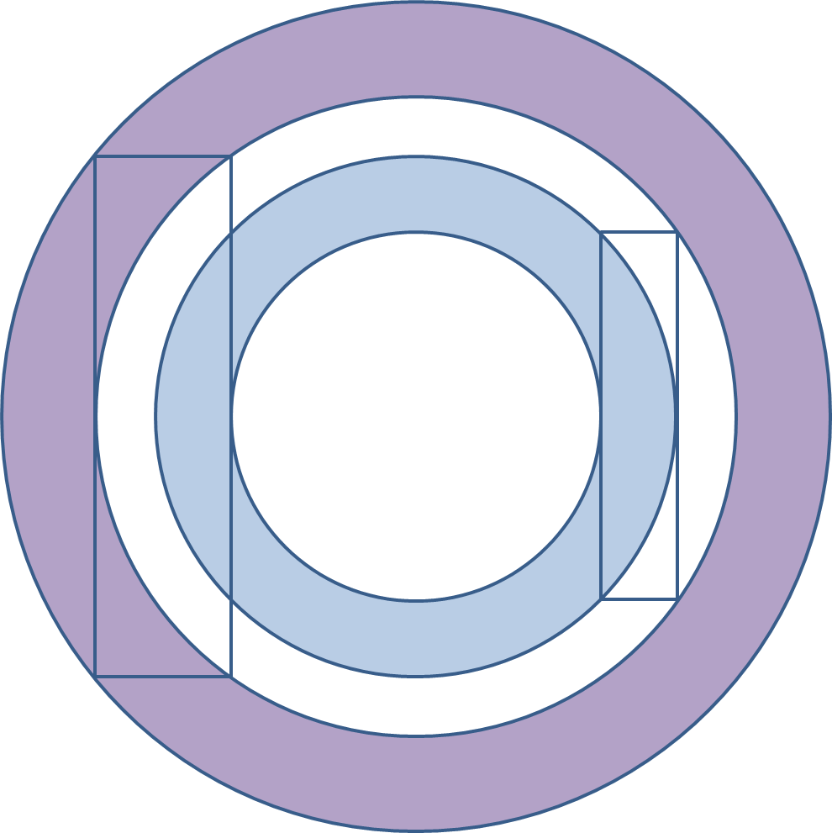
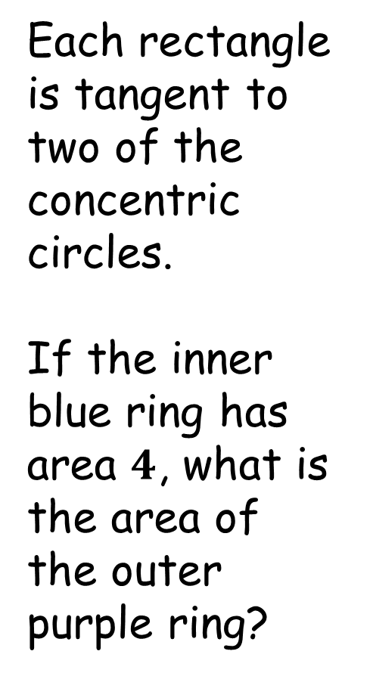
Extension:
Each rectangle is tangent to two of the concentric circles.
If the inner blue ring has area $4$, what is the area of the outer purple ring?
Notes:
Source: Catriona Shearer.

Slide 15


Extension:
Each rectangle is tangent to two of the concentric circles.
If the inner blue ring has area $4$, what is the area of the outer purple ring?
Area $4$
Area $4$
(Same chord lengths)

Slide 16
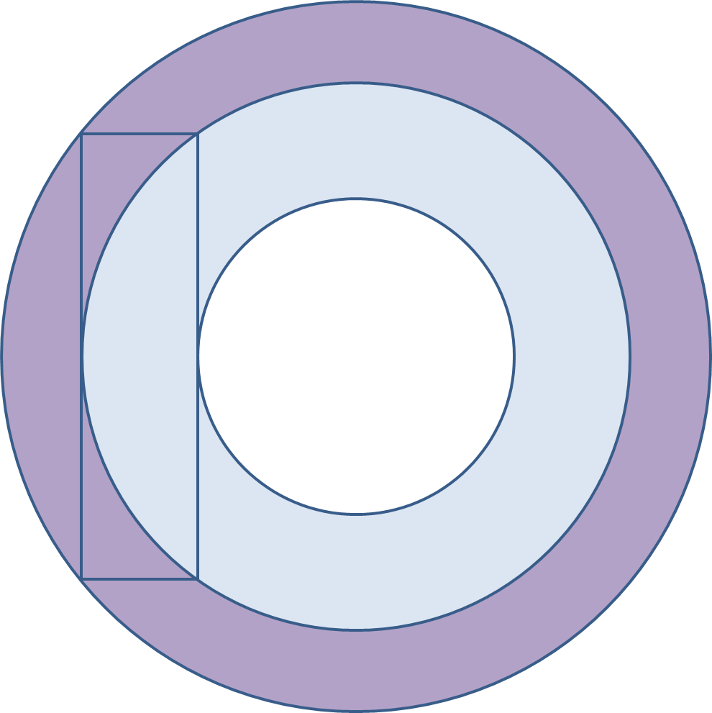


Extension:
Each rectangle is tangent to two of the concentric circles.
If the inner blue ring has area $4$, what is the area of the outer purple ring?
Area $8$
Area $8$
(Same chord lengths)

Slide 17
Extension:
Each rectangle is tangent to two of the concentric circles.
If the inner blue ring has area $4$, what is the area of the outer purple ring?
Area $4$
Area $8$

Slide 19

Note to teacher
The regular polygons are red herrings, all that counts is the chord length, $l$.

Slide 20
Resources

Slide 21
Polygon in Annulus
Each figure shows a regular polygon (with a given side length) just touching two circles.
What is the area of each annulus, i.e. the area enclosed by the circles, in terms of π?
$$2$$
SIC_18
$$2$$
Notes:
3 5

Slide 22


Polygon in Annulus
Each figure shows a regular polygon (with a given side length) just touching two circles.
What is the area of each annulus, i.e. the area enclosed by the circles, in terms of π?
$$2$$
SIC_18
$$2$$
Notes:
4 6

Slide 23


Polygon in Annulus
Each figure shows a regular polygon (with a given side length) just touching two circles.
What is the area of each annulus, i.e. the area enclosed by the circles, in terms of π?
SIC_18
$$2$$
$$2$$

Slide 24


Polygon in Annulus
Each figure shows a regular polygon (with a given side length) just touching two circles.
What is the area of each annulus, i.e. the area enclosed by the circles, in terms of π?
$$2$$
$$2$$
SIC_18

Slide 25


Polygon in Annulus
Each figure shows a regular polygon (with a given side length) just touching two circles.
What is the area of each annulus, i.e. the area enclosed by the circles, in terms of π?
$$2$$
$$2$$
SIC_18

Slide 26

Polygon in Annulus
Each figure shows a regular polygon (with a given side length) just touching two circles.
What is the area of each annulus, i.e. the area enclosed by the circles, in terms of π?
$$2$$
SIC_18
$$2$$

Slide 27
Extension:
Each rectangle is tangent to two of the concentric circles.
If the inner blue ring has area $4$, what is the area of the outer purple ring?
SIC_18
Notes:
Source: Catriona Shearer.

Slide 28
Extension:
Each rectangle is tangent to two of the concentric circles.
If the inner blue ring has area $4$, what is the area of the outer purple ring?
SIC_18
Notes:
Source: Catriona Shearer.

Slide 29
Source
In case future adjustments/improvements are required

Slide 30
Each rectangle is tangent to two of the concentric circles.
If the inner blue ring has area $4$, what is the area of the outer purple ring?
Notes:
Source: Catriona Shearer.

Slide 31


Each rectangle is tangent to two of the concentric circles.
If the inner blue ring has area $4$, what is the area of the outer purple ring?
Area $4$
Area $4$
(Same chord lengths)

Slide 32


Each rectangle is tangent to two of the concentric circles.
If the inner blue ring has area $4$, what is the area of the outer purple ring?
Area $8$
Area $8$
(Same chord lengths)

Slide 33
Each rectangle is tangent to two of the concentric circles.
If the inner blue ring has area $4$, what is the area of the outer purple ring?
Area $4$
Area $8$

